Slide 1
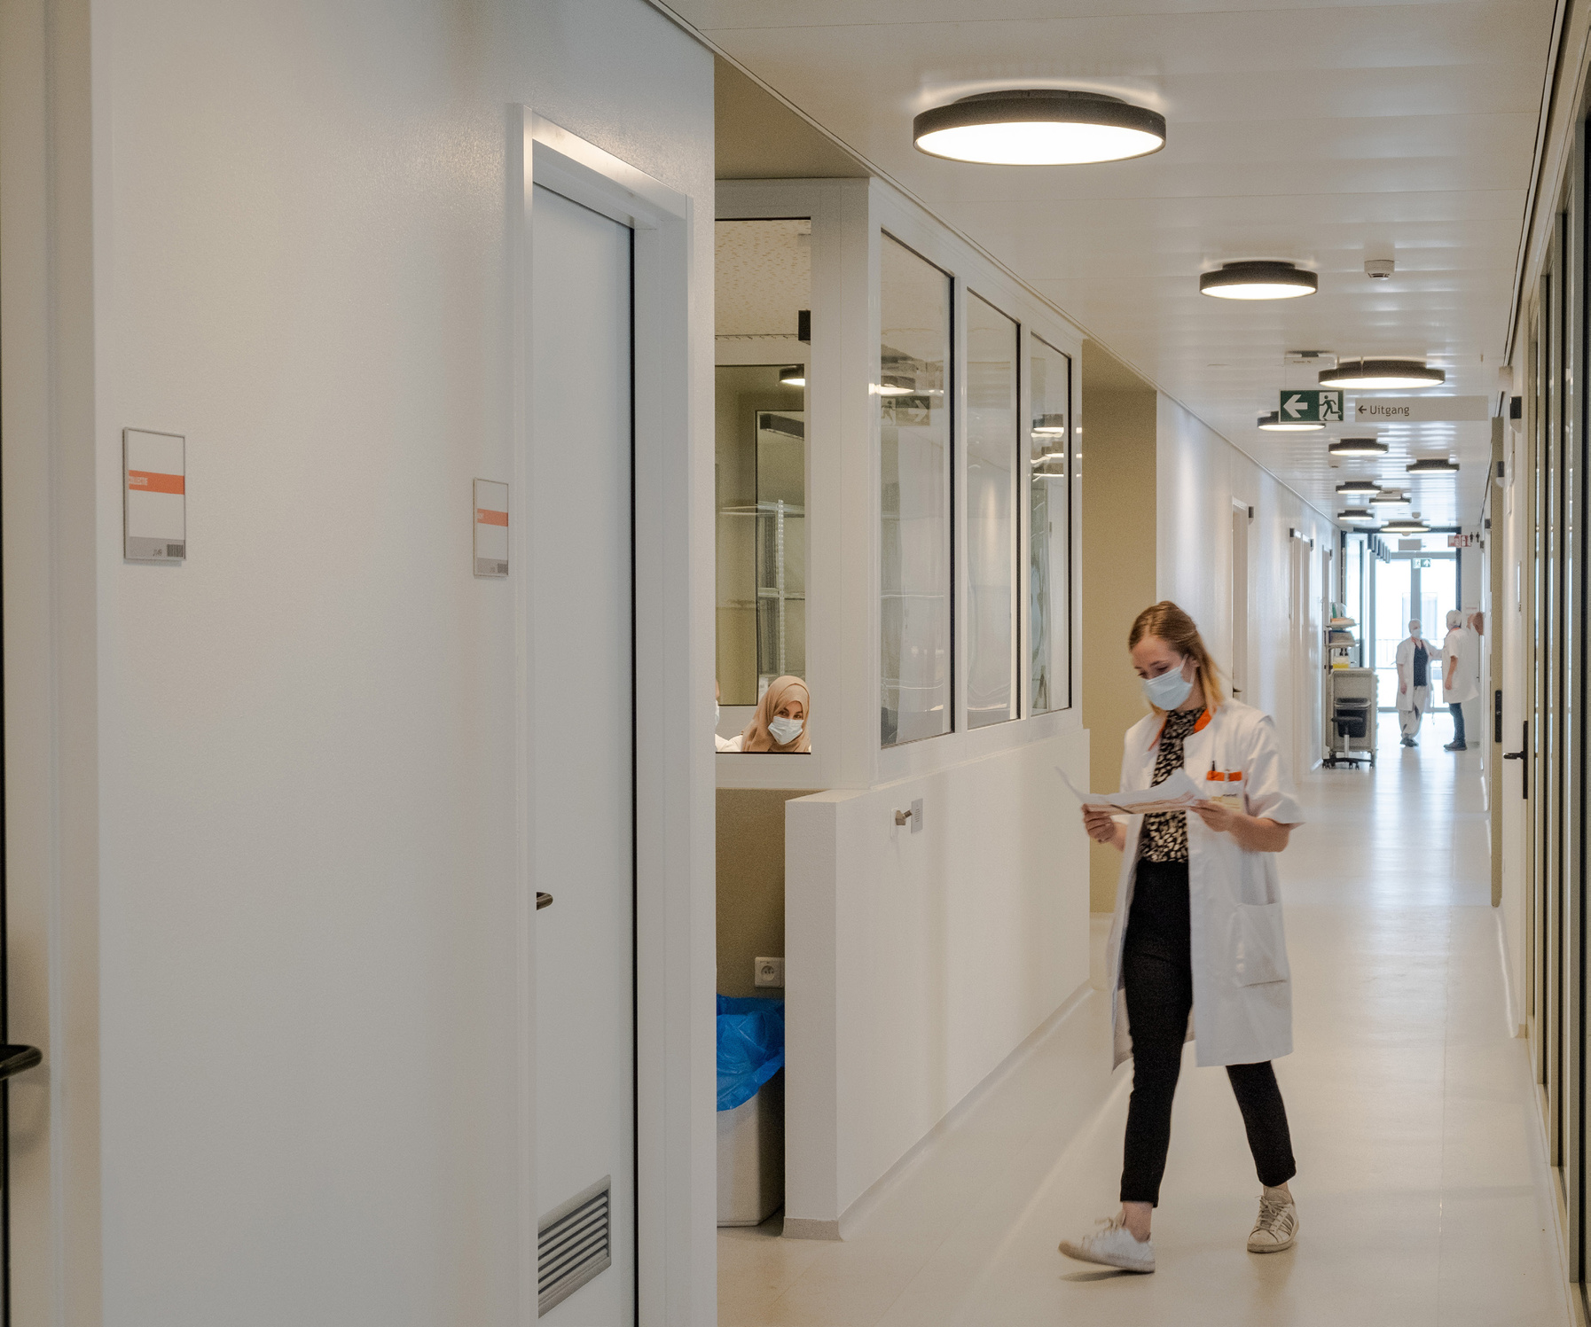

Medical Innovation with Ethics
Empowering Advances in Healthcare with Ethical Clinical Research

Slide 2



Transforming Clinical Trials with Ethics and Expertise
At Methics, we believe that medical advancements and ethical principles go hand in hand. Our mission is to push the boundaries of what’s possible in healthcare by conducting clinical trials that are safe, effective, and respectful of human rights.
We leverage the latest technology and innovative methods to design and execute clinical trials that deliver meaningful results.
We are a boutique clinical research organization that is dedicated to providing a full range of clinical trial services. Our team of experienced professionals and global partners work together to deliver innovative and ethical solutions for every step of the clinical trial process.

Slide 3


End-to-End Clinical Research Solutions
While each of our departments’ services can bring you value on their own, you can also benefit from end-to-end clinical trial solutions that provide support from ideation all the way to successful market entry. Enjoy the ease of working with several departments all housed under one roof that work in cohesion to quickly address your organization’s specific needs.
Methics is a well-structured organization with deep clinical research experience team, which means we have the flexibility to provide you with tailored solutions for all the clinical research challenges you might face. Our experienced professionals have the ability to work together within limited timeframes and provide you with the rapid set-up times to accelerate your product’s development life cycle and efficiently meet your clinical goals.

Slide 4








DISCOVERY
DEVELOPMENT
POST-MARKETING
Full Flexibility through 100% Customization
We are a full service CRO. We take this literally – whether you choose all or some of our service functions. Our service is always tailored to your needs and reflected in everything we do.
Clinical
Operations
Medical
Monitoring/
Safety
Management
Regulatory
Affairs
Data
Management
Quality
Assurance
Bio-
Statistics
Project
Management
Medical
Writing

Slide 5

Reliable, Faster & Innovative Team that sets us Apart
  Well established and stable team
  Highly skilled and experienced
  Pro-active and open communication
  Ownership over the responsibilities
  Implementing smart and practical solutions
  Measurable performance through Milestone
  Quick responsiveness and reaction time

Slide 6
Clinical Team Experience
  With 100+ Clinical Trial experience in various Therapeutics
Phase 1
15%
Phase 4
27%
Nutraceutical Products
24%
Chemical Products
33%
Phase 2
15%
Medical Devices
26%
Biological Products
17%
Phase 3
43%

Slide 7
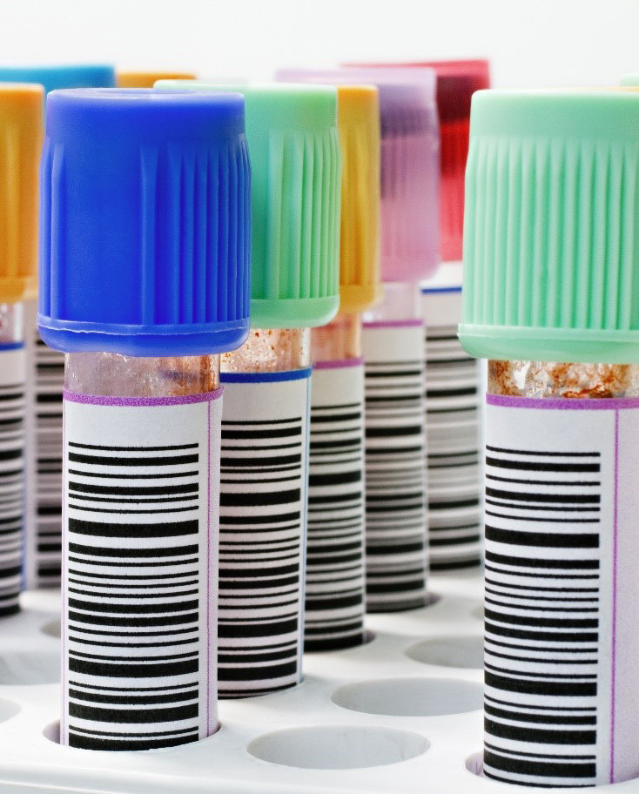
Wide Range of Therapeutic Areas experiences
  Cardiovascular
  Ophthalmology
  Oncology
  Respiratory
  Gastroenterology
  Infectious disease
  Psychiatric
  Dermatology
  Nephrology
  Orthopedic
  Vaccine Development

Slide 8


Clinical Operations
  Feasibility studies
  Site Selection and Initiation
  Monitoring- Onsite/Remote/Centralize
  Close out
  Patient Recruitment support
  Site Management
Navigating the Complexities of Clinical Operations with Ease

Slide 9



Project Management
  Scientific Leadership
  Project planning, execution and monitoring
  Provide project progress report
  Risk Management
  Stake holder and vendor management
  Incorporate quality best practices
  Put Strategic plan into practice
  Management of regulatory and compliance strategies
Turning complex projects into simple solutions

Slide 10

Medical Monitoring
  Medical inputs in protocol development
  Safety Management Plan
  Medical Monitoring Plan
  Clinical case review
  Medical and safety line listing review and discussion
  Medical coding review
  SAE/SADE/Pregnancy cases review
Ensuring Patient Safety,
One Step at a Time.

Slide 11

Medical Writing
  Clinical Study Protocol /Investigation Plan
  Investigator’s brochures (IB)
  Consent documents
  Patient scales and patient diary cards
  Clinical Study/Investigation Report
  Manuscript writing
  Scientific document
Translating complex science into clear communication

Slide 12

Regulatory Affairs
  Clinical Regulatory Strategy Development
  Clinical & Non-Clinical overview (2.4 & 2.5) Writing
  Expert statement clinical and non clinical signature of expert
  Drafting SmPC, PILs, PIs, Medical Guide
  Environmental Risk Assessment
  Permitted daily Exposure
  Module 4 writing and review cover the Preclinical activity
  Dossier compilation & Review
  Regulatory writing and reporting
Your partner in regulatory compliance and success.

Slide 13

Quality Assurance
  QMS Setup
  Vendor qualification
  Computer System Validation (CSV)
  Pre- Audit/ Inspection readiness
  Change Management
  Deviation Management
  GxP/Compliance Audits
Quality as a principal guidance for all Research

Slide 14

Data Management
  EDC Selection and End-User training
  Data Management Plan
  Database design, development and maintenance
  Data cleaning and query management
  Medical coding (WHO-DD and MedDRA)
  SAE/SADE and third party data Reconciliation
  Data base lock, transfer and archival
Unlocking the Power of Your Data with Precision and Quality

Slide 15


Biostatistics
  Study design and protocol development
  Sample size calculation
  Randomization schemes
  Statistical Analysis Plan
  Statistical Analysis and report
  Integrated safety and efficacy analysis
  Data Monitoring Committee Services
  SDTM and ADaM data set preparation
Redefining the future of healthcare through data analysis.

Slide 16

Team experience in e-Tools
  EDC
  IWRS/RTSM
  CTMS
  eTMF
  rSDV
  ePRO
  eCOA
  eConsent

Slide 17
Medical device & IVD Solution
  ISO 13485 Quality Management System setup and implementation
  Product Registration and Market Authorization
  Import and Export compliance for Medical Devices & IVDs
  CE Marking documentation in accordance with MDR / IVDR
  Medical Device Single Audit Program (MDSAP) preparation
  510(k) application preparation and submission (FDA)
  Clinical Evaluation Report (CER) writing
  Clinical investigation planning and management
  Post-Market Clinical Follow-Up (PMCF)
Your trusted partner for regulatory excellence and clinical success.
  We provide comprehensive support across the entire lifecycle of Medical Devices (MD) and Vitro Diagnostics (IVDs), ensuring compliance, efficiency, and market success.

Slide 18
Clinical Project Workflow
Study
planning
Feasibility and Site Selection
Database Design
Regulatory and Ethics
Committee Submissions
Execution
Statistical Analysis
Clinical Study Reports
Regulatory Strategy
Scientific Advice
Study Planning and Design
Medical Writing
Project and Site Management
Clinical Monitoring
Clinical Safety
Medical Monitoring
Data Management
Start-up
Delivery

Slide 19
Quality You Can Rely Upon
Well-established
Quality Management
system
In-House
Designed
SOPs
System
Audit by
Sponsors
FDA / EMA
Acceptable
Data

Slide 20
Why Choose Methics?
Our participants are at the heart of everything we do, and we are committed to providing them with the best possible care and support throughout the clinical trial process.
We use the latest technology and innovative methods to design and execute clinical trials that deliver meaningful results.
Ethical Approch
Experience
We are guided by a strong commitment to medical ethics and human rights, and we work tirelessly to ensure that all of our clinical trials are conducted with the utmost integrity
Our team of experts has extensive experience in the design, execution, and management of clinical trials
Patient Care
Cutting-Edge Technology

Slide 21
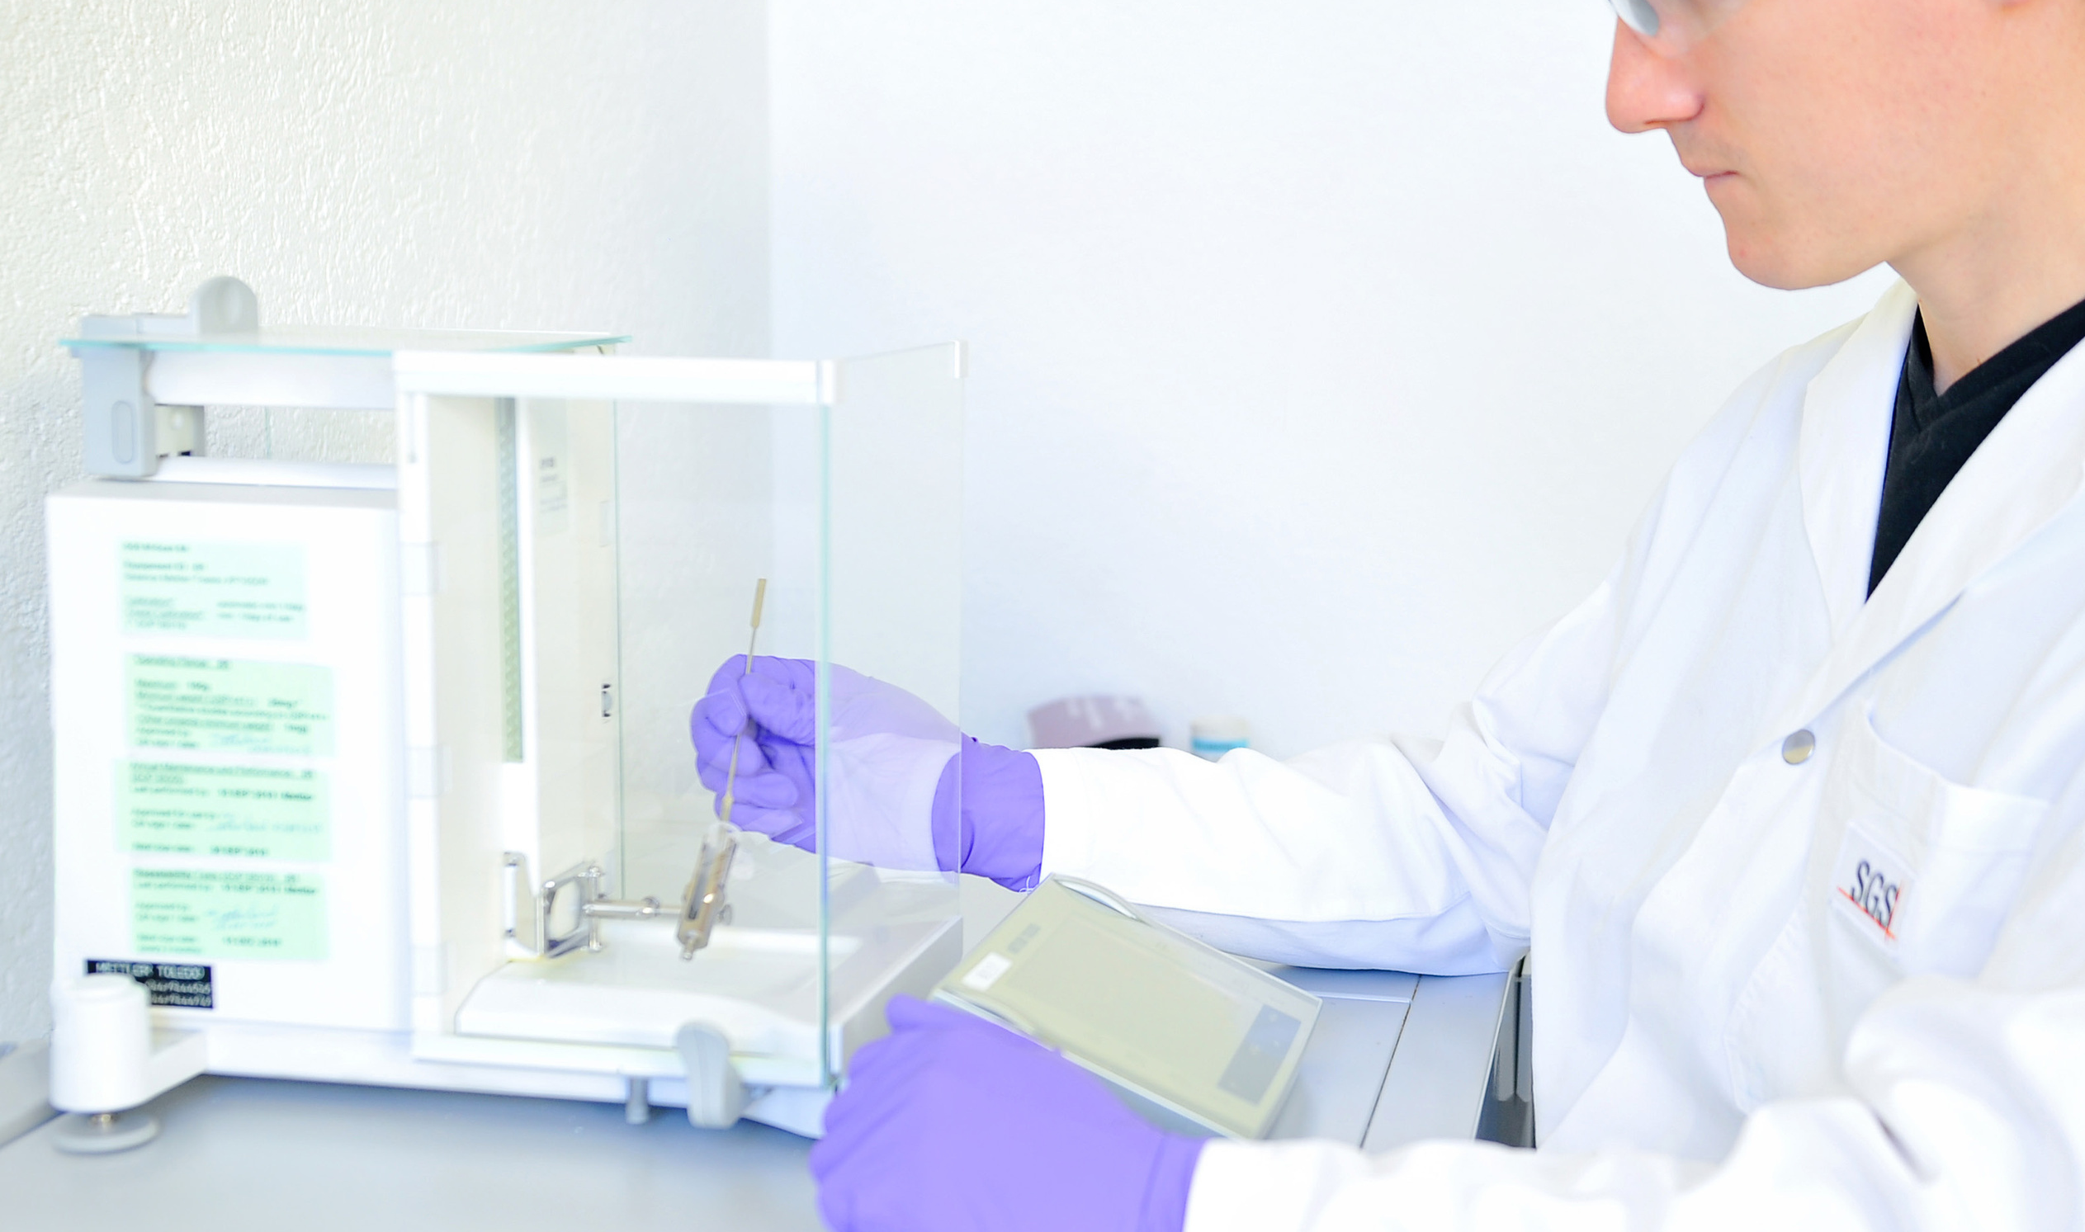



Whatever your concern, we are here to help!
Contact Us
bd@methicsclinical.com
www.methicsclinical.com
S-05 & S-06, Second Floor, Kalaji Business Centre,
Near Saurashtra Kadva Patidar Vadi, Dharampur Chokdi, Abrama, Valsad – 396002, Gujarat, India.

